Slide 1
Activity 3.2: Planning a video advert (Part one)
On the next slides, you will see the beginnings of a timeline for the Hachette Travel video advert.
Listen to the audio files and look at the suggested videos and voiceover script that you have been provided with by your client, Hachette Travel. You can download background music of your choice from www.bensound.com.
Decide which sounds and images to use in your advert and drag them into position on the timeline. You will have to resize the blocks but do not rename them.

Slide 2
Remember
The advert must:
be no longer than 30 seconds
include a voiceover
include background music
include at least three audio effects
include at least five different video clips
include Hachette Travel’s logo, which should be on screen throughout
include at least three visual effects.

Slide 3
Video and audio clips you can use
Copy the video clips and audio clips you wish to use and paste them on the next slide, then move them to where you want them to appear in your video advert. One video clip and one audio clip have already been placed.
Suggested videos:
Audio clips you can use:
Hiking
Plane in the sky
Beach noise
Passengers boarding plane
New York – Times Square
Forest noise
Footsteps in the sand
Ski resort
Ski lift noise
Boats on the ocean
Palm trees
Voiceover
Video clip of your choice …
Video clip of your choice …
Plane engines
Background music

Slide 4
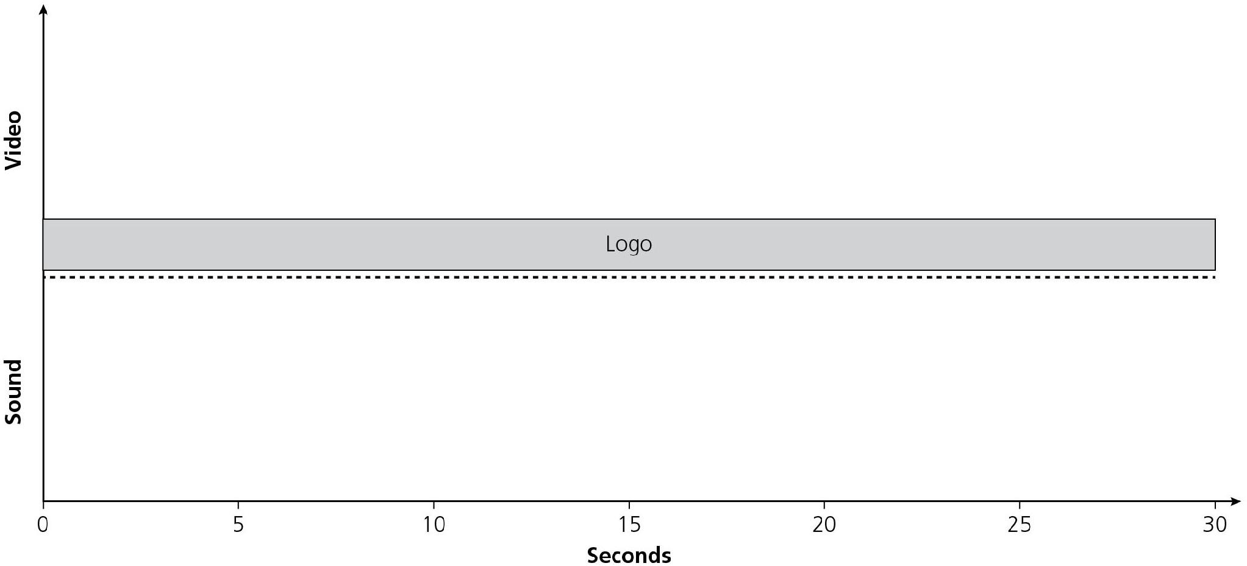
Video and audio clips you can use
Passengers boarding plane
Plane engines

Slide 5
Activity 3.2: Planning a video advert (Part two)
You know how to add the following audio effects when designing sound:
fade in/fade out
reverb
compression
envelope.
Annotate your timeline to include at least three audio effects. Do this by adding a text box containing the name of each audio effect and why you want to use it next to the sound you want to apply it to.

